Slide 1
Data Science
Project Presentation
Topic: Diabetes Prediction

Slide 2
Part 1 Project Summary
Women of prima Indian origin greater than age of 21.
Aim is predicting diabetes with ML algorithm.
Major findings: Correlations between features and outcome.

Slide 3
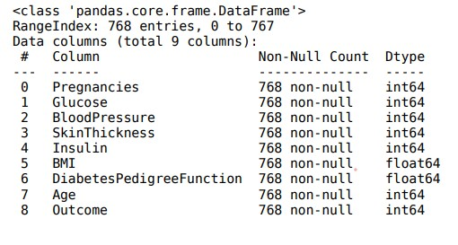
Part 2 Dataset Description
768 and 8 features sample at the beginning

Slide 4
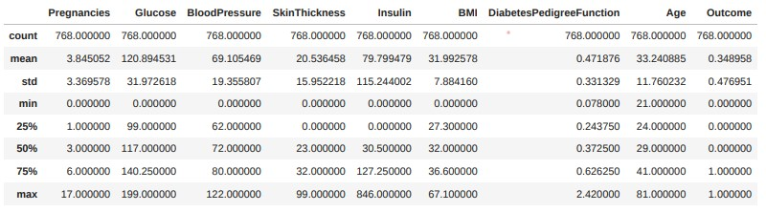
Part 2 Basic Descriptive Statistics
matrix, heatmap, boxplot, displot, scatterplot, subplot functions
647 missing value / 10.53%
Boxplot used to display ourliars

Slide 5
Part 3 Data Management Process
1 Excel file
Missing BMIs and Glucoses are dropped
Insulin and SkinThickness filled using KNNimputer
45 Outliers are removed
No transformation method
Standard scaling for KNN classificator
Pipelining for Logistic Regression

Slide 6
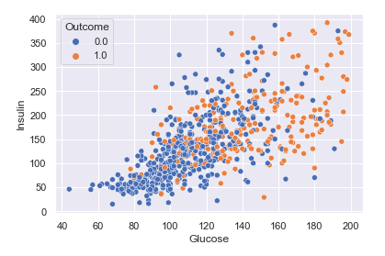
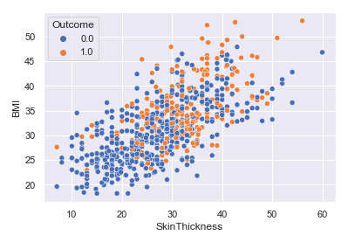
Part 4 Data Visualization
Relationship between the pairs of the variables(bivariate graphs)

Slide 7
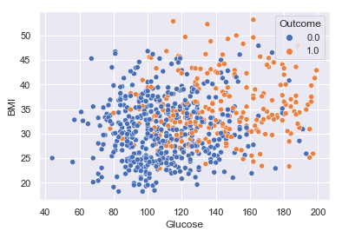
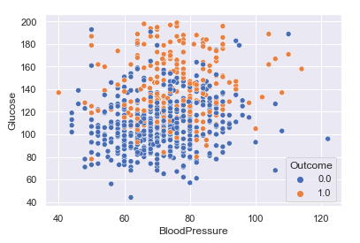
Part 4 Data Visualization
Relationship between the pairs of the variables(bivariate graphs)

Slide 8
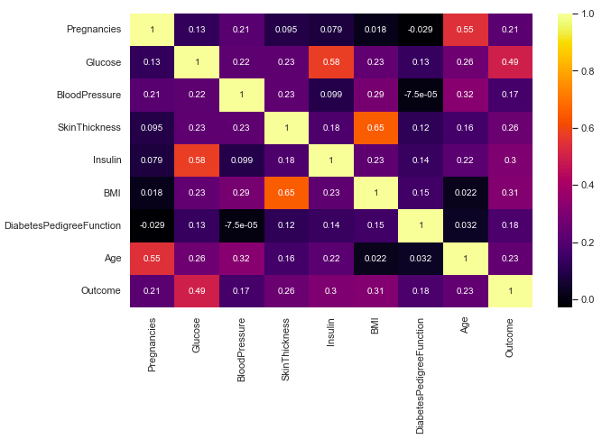
Part 4 Data Visualization

Slide 9
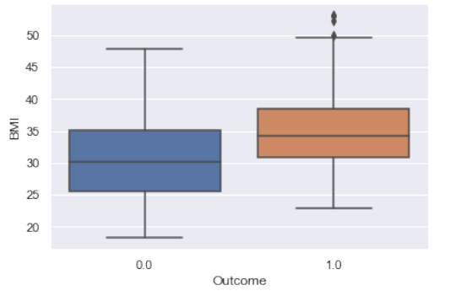
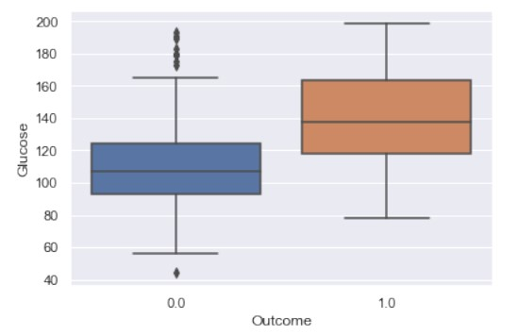
Part 5 Data Analysis

Slide 10
Part 6 Machine Learning Implementation: Model Selection and Evaluation
Binary classification
Confusion metrics to evaluate the algorithms(also shown the precision,recall and f1-scores)
KNN and Logistic Regression algorithms
Best parameters using GridSearchCV
Most impactful features
Correlation matrix with heatmap as feature selection
Increase in model performance
Every feature is included

Slide 11
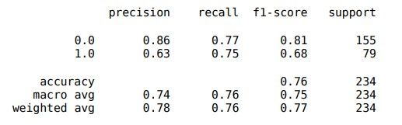
Part 7 Results
Combining models with hard voting
Most effectives insulin and glucose
Least effective pedigree function and blood pressure
Combined model has better result.

